Slide 1
Collision: Bounce
Resolving collision with a bounce
Programming – Maths for Games

Slide 2
Collision Resolution
When two objects collide, we need to separate them.
This often just means pushing them apart again.
If that’s all we do, then they’ll collide again next frame.
A bounce is a nice way to change the direction of the object so it doesn’t keep colliding.

Slide 3
Bounce!

Slide 4
Normals
First we need to calculate the “normal”.
Every surface or face has a normal.
A Vector at right angles to the surface that points outwards.
Always normalised which is where it gets its name.
N

Slide 5
Normals
Every face of an object has its own normal

Slide 6
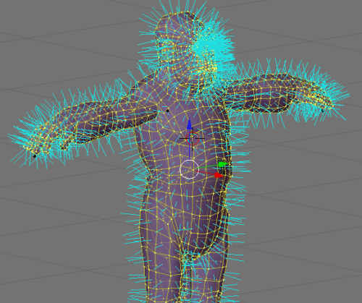
Normals
Normals are very common in games
Every triangle in a 3D model has a normal
Used to calculate lighting, collision, and post-effects.

Slide 7
Calculating Normals
We can calculate the normal using the face’s corners
N
P1
P2

Slide 8
Calculating Normals
First we subtract one from the other to get the Vector between them…
A = P2 – P1
A
P1
P2

Slide 9
Calculating Normals
Then we normalise it…
B = normalize(A)
B

Slide 10
Calculating Normals
And finally rotate it by 90 degrees
N.x = B.y
N.y = -B.x
N

Slide 11
Calculate the Bounce
To calculate the bounce we use the following formula
R = V – 2(V⋅N)N
V: The velocity of the ball
N: The normal of the surface it hit
R: The new velocity of the ball after it has bounced
N
V
R

Slide 12
Bouncing in Code
Here is the pseudocode
//Calculate Normal
Vec = point2 – point1
Vec = normalise(Vec)
Normal.x = Vec.y
Normal.y = -Vec.x
//Calculate Bounce
NewVelocity = Velocity – 2 * Dot(Velocity, Normal) * Normal

